Slide 1

Delight Dairy

Slide 2
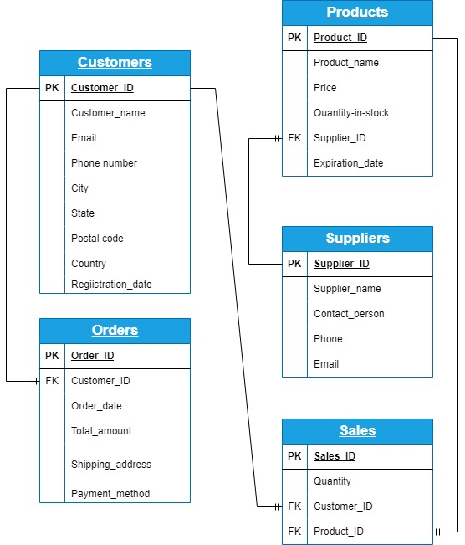
ER-DIAGRAM

Slide 3
ABSTRACT
The Dairy Business Database project is designed to create a comprehensive and efficient MySQL database system to manage and streamline operations within a dairy business. The primary objective is to facilitate the systematic storage, retrieval, and management of crucial business data including sales, customer details, supplier information, products,order details. This project encompasses the design and implementation of relational database schemas, ensuring data integrity, and establishing relationships among various entities involved in the dairy business.
Additionally, it will provide robust querying capabilities to generate insightful reports, aiding in decision-making processes.By implementing this MySQL database, the dairy business can enhance its operational efficiency, improve data accuracy, and ensure timely access to vital information, ultimately contributing to better resource management and customer satisfaction.

Slide 4
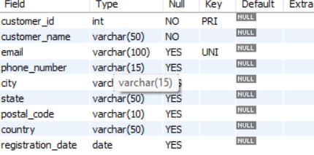
STRUCTURE OF CUSTOMERS TABLE
This table shows the information about
customers like their name,email,phone number,
city,state,postal code,country,registration date.
Syntax : desc customers;

Slide 5
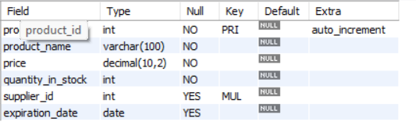
STRUCTURE OF PRODUCTS TABLE
This table shows the information about the products.
Syntax: desc products;

Slide 6
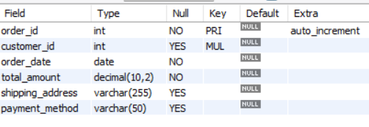
STRUCTURE OF ORDERS TABLE
This table shows the details of orders like order_id,
Customer_id,order_date,total_amount,
Shipping_address,payment_method.
syntax: desc orders

Slide 7
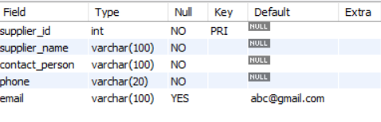
STRUCTURE OF SUPPLIERS TABLE
This table shows the information about the suppliers
Like name,contact person,ohone,email.
Syntax: desc suppliers;

Slide 8
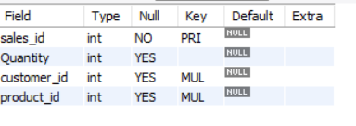
STRUCTURE OF SALES TABLE
This table shows the information about the sales details
like sales_id, quantity,customer_id,product_id.
Syntax: desc sales;

Slide 9
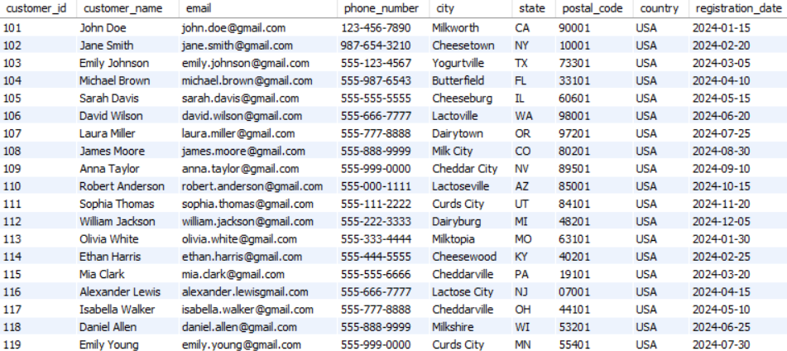
Contents of customers table
select * from customers

Slide 10
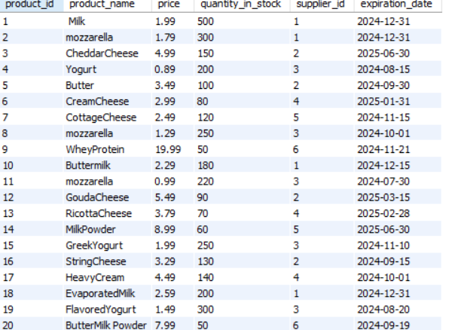
Contents of products table
Select * from products

Slide 11
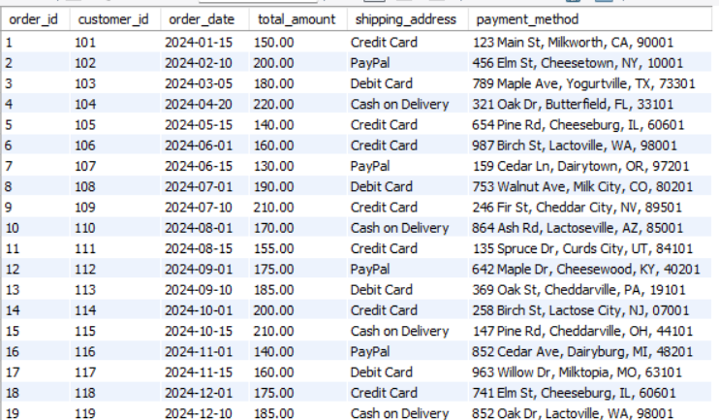
Contents of orders table

Slide 12
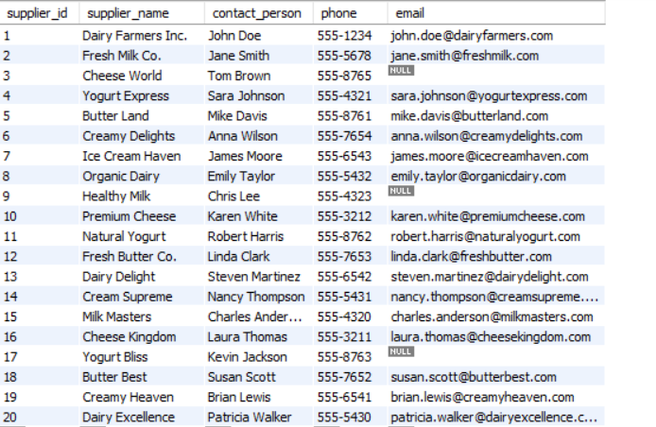
Contents of suppliers table
Select * from suppliers

Slide 13
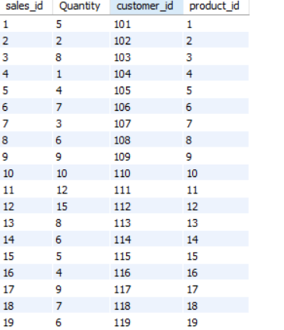
Contents of sales table
Select * from sales

Slide 14

Multiple subqueries
Display the customers who has purchased
the most expensive products
select customer_name from customers where customer_id in(select customer_id from orders where product_id in(select product_id from products where price=(select max(price) from products)));

Slide 15

Multiple subqueries
Display the how many customers have purchased the product named "mozzarella"
select count(customer_name) from customers where customer_id in(select customer_id from orders where product_id in(select product_id from products where product_name="mozzarella"));

Slide 16

Multiple subqueries
Display the products which will expire within the next 30 days, and what are their expiration dates?
SELECT product_name, expiration_date FROM Products WHERE expiration_date <= DATE_ADD(CURDATE(), INTERVAL 30 DAY);

Slide 17
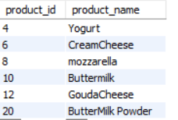
Multiple subqueries
Display the products that not been ordered yet
SELECT product_id,product_name FROM Products WHERE product_id not IN ( SELECT DISTINCT product_id FROM Orders);

Slide 18
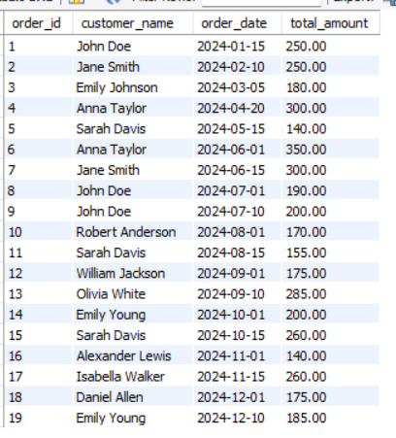
Joins
Display all the customers with their orders
SELECT Orders.order_id, Customers.customer_name, Orders.order_date, Orders.total_amountFROM Orders INNER JOIN Customers ON Orders.customer_id = Customers.customer_id;

Slide 19
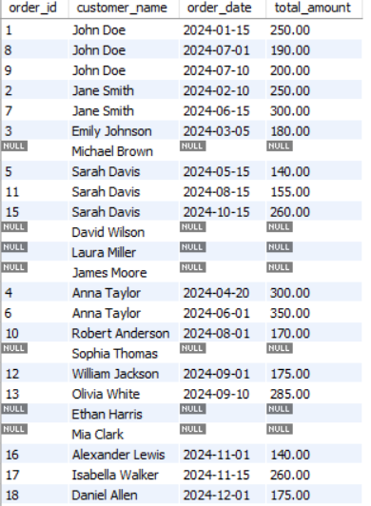

Joins
Display All Customers with or without Sales
SELECT Orders.order_id, Customers.customer_name, Orders.order_date, Orders.total_amountFROM Orders RIGHT JOIN Customers ON Orders.customer_id = Customers.customer_id;

Slide 20
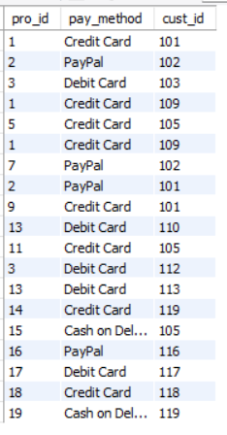
Joins
Identify the product IDs and payment methods from orders,
along with the customer IDs for related products. Specifically,
match each order's order_id with another order’s product_id to find related information.
select o1.product_id as pro_id , o1.payment_method as pay_method,o2.customer_id as cust_id from orders o1 join orders o2on o1.order_id=o2.product_id;

Slide 21
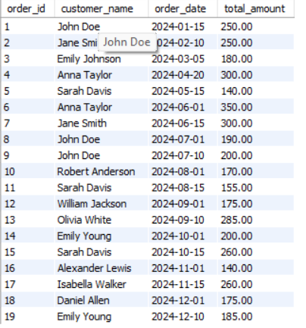
Joins
Include All Products with or without Sales
SELECT Orders.order_id, Customers.customer_name, Orders.order_date, Orders.total_amountFROM Orders
LEFT JOIN Customers ON Orders.customer_id = Customers.customer_id;

Slide 22
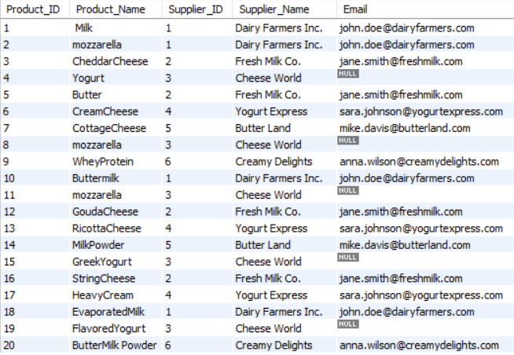
Views
View for Product Supplier Details
CREATE VIEW ProductSupplierDetails ASSELECT p.Product_ID, p.Product_Name, s.Supplier_ID, s.Supplier_Name, s.Email FROM Products pJOIN Suppliers s ON p.Supplier_ID = s.Supplier_ID;

